Slide 1


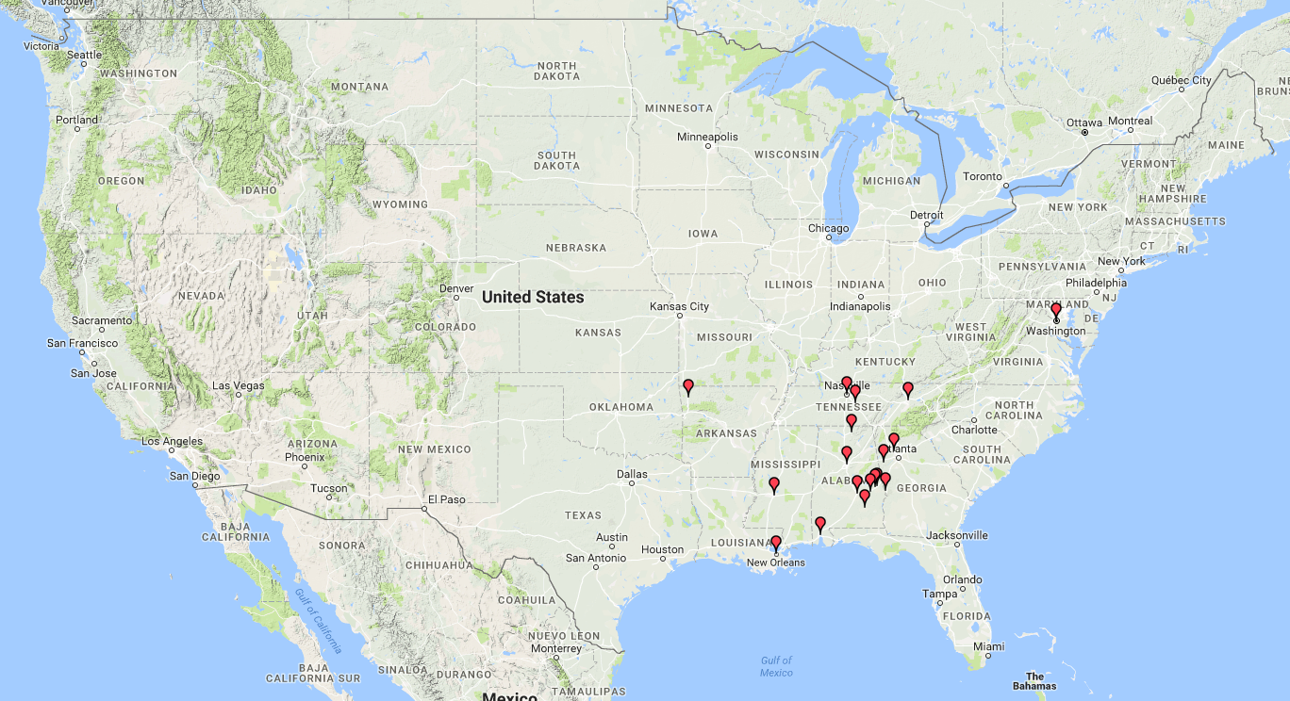
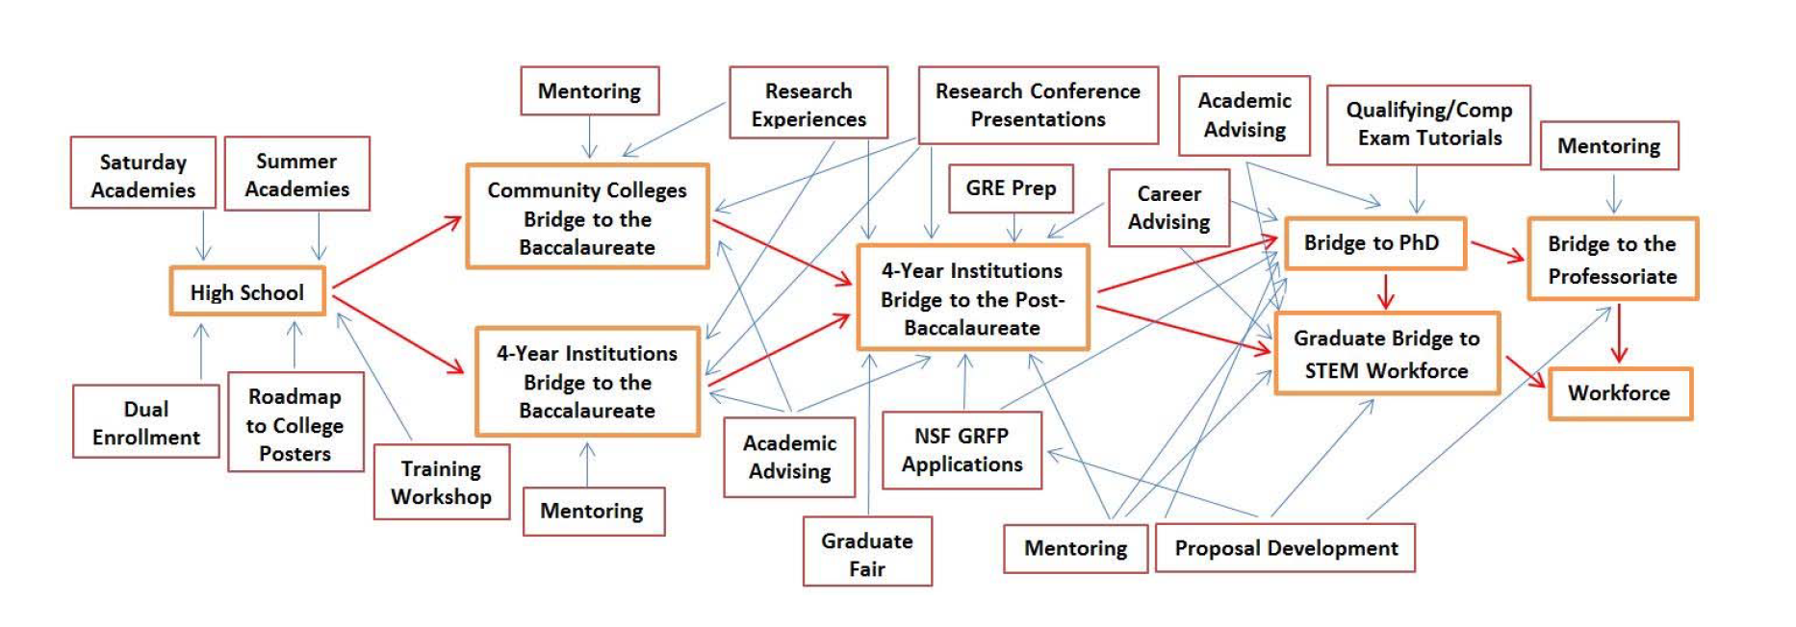
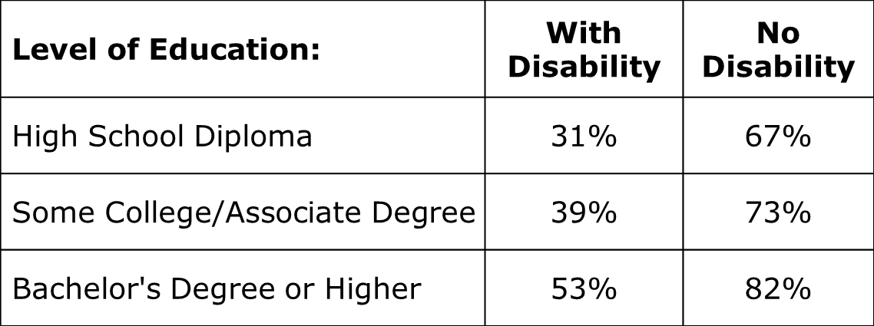
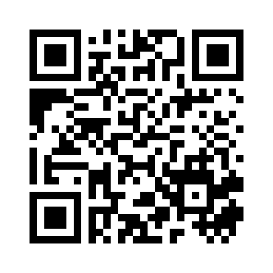

Building Bridges: How the Southeast is Increasing the Representation of Students with Disabilities in STEM
SIGCSE 2017
Daniela Marghitu
Computer Science and Software Engineering Department
Auburn University
daniela@eng.auburn.edu
Amber Wagner
Computer Science Department
Kennesaw State University
ankwagner@gmail.com
BACKGROUND
Principle Investigators
The SEAPD-STEM is an alliance consisting of 22 higher ed institutions including community colleges, four-year institutions, and universities with graduate programs
SEAPD-STEM builds on the success of the Alabama Alliance for Students with Disabilities in STEM (AASD-STEM), expanding the project from 5 institutions in Alabama to 22 institutions throughout the Southeast
Dr. Overtoun Jenda (Auburn University), Dr. Maithilee Kunda (Vanderbilt University), Dr. Carl Pettis (Alabama State University), Dr. Mohammed Qazi (Tuskegee University)
Bridge model
Bridge to Baccalaureate Peer-Mentoring Program Goal: transition freshman/sophomores to juniors/seniors
Bridge to Post-Baccalaureate Peer-Mentoring Program Goal: transition into graduate school or STEM workforce
Horizontal Peer Mentoring
Vertical Peer Mentoring
RESEARCH GOALS
Increase the quality and quantity of persons with disabilities completing associate, undergraduate, and graduate degrees in STEM disciplines and entering the STEM workforce.
Increase the quality and quantity of post-doctoral fellows and junior faculty with disabilities in STEM fields.
Improve academic performance of students with disabilities in secondary level science and mathematics courses.
Enhance communication and collaboration among post-secondary institutions and other organizations in addressing the education of SWD in STEM disciplines.
Assess our activities to understand what works and disseminate findings.
Project Objectives
Juniors
Sophomores
Seniors
Freshman
High School Students
Graduate Students/ STEM Workforce
Implement the Bridge Model
Implement SEAPD-STEM training workshops
Implement NSF INCLUDES Alliances planning workshops in each participating state
Gatherenrollment,retention,andgraduationbaselinedataforSTEMstudentswith disabilities by race, ethnicity, and gender
Identify schools and school districts for each of the participating institutions for outreach activities
Add at least one community college to partner with each Alliance college or university, and
Engage additional partners including national and local labs, etc.
Consists of clusters of ten or fewer students
There will be a face-to-face meeting and then students will meet virtually
Activities may include sharing research papers or interesting events from class
Students will also share interesting or fun events from outside of class
Interventions
Selected intervention activities are described below:
Bridge to post-baccalaureate peer-mentoring
Research internships
Research conference presentations
SEAPD-STEM research conference and graduate school fair
Preparation for GRE
Literature search and technical writing workshops
Proposal development workshops
Evaluation
Retention and successful progression through STEM degree programs and into STEM workforce positions.
Employment percentages, persons ages 21-64:
Erickson, W., Lee, C., von Schrader, S. (2015). Disability Statistics from the 2013 American Community Survey (ACS). Ithaca, NY: Cornell University Employment and Disability Institute (EDI).
Quantitative
Qualitative
Multiple Case Studies
Prototype Potential
This project is supported by NSF award number 1649276.
Internal evaluator (site-level): Dr. David Shannon, Auburn University.
External evaluator (alliance-wide): Dr. Linda Thurston, Kansas State University.
Notes:
1
1
1
1

